Slide 1
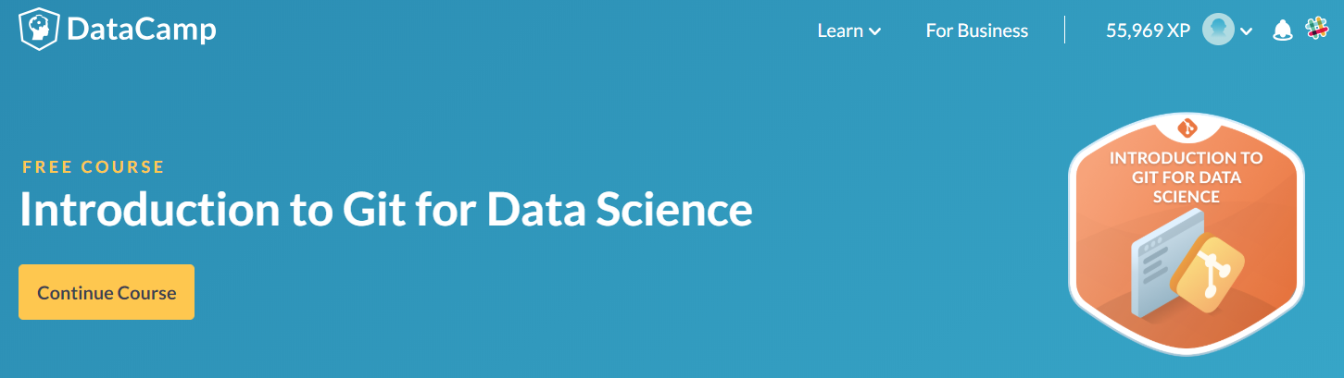
Introduction to Git for Data Science (DataCamp)
陽明生資所 陳卓逸老師實驗室
專任研究助理 陳躍中 製作 2018.07.12
https://www.datacamp.com/courses/introduction-to-git-for-data-science

Slide 2
Content
1.Basic workflow
2.Repositories
3.Undo
4.Working with Branches
5.Collaborating

Slide 3
Introduction to Git for Data Science (DataCamp)
Version Control System 版本控制系統
Git 為其中一種版本控制系統
You can always go back to see which results were generated by which versions of your programs.
Git will automatically notify you when your work conflicts with someone else’s. (prevent overwrite)
Git can synchronize work done by different people on different machines.

Slide 4
Where does Git store information?
Git projects (files, directories / extra information):
Repository
Files and directories that you create and edit directly.
包含
Extra information that Git records about the project’s history
Git stores all of its extra information in directory called .git which located in the root directory of the repository.
Git expects this information to be laid out in a very precise way, so you should never edit or delete anything in .git.

Slide 5
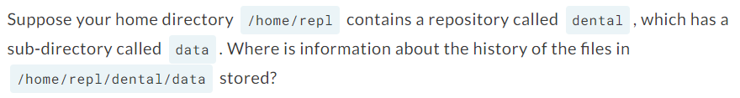
Pop quiz:
由於題目是要問 Git 將 /home/repl/dental/data 的資料存在哪裡？
尋找 data 資料夾的 root 資料夾，
故答案為 /home/repl/dental/.git

Slide 6
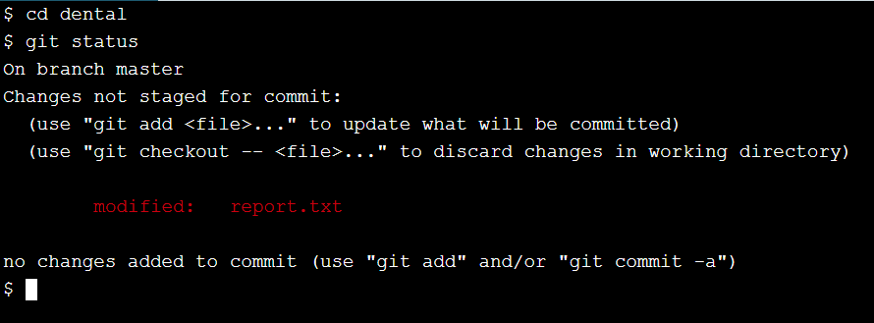
How can I check the state of a repository?
檢測目前 git 狀態的指令：< git status >
從上圖終端機結果可以知道輸入 git status 後可以看到在 dental repository 中，距離上一次儲存後，有被更改過的檔案為 report.txt

Slide 7
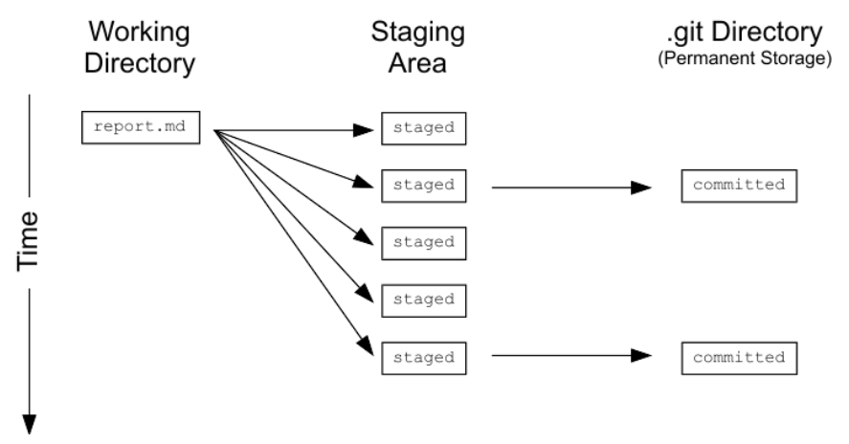
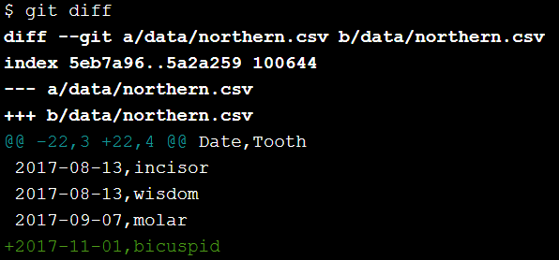
How can I tell what I have changed?
Git has a staging area in which it stores files with changes you want to save that haven't been saved yet.
<git diff> 可以查詢你曾經在此 repository 中修改過什麼樣的檔案。(接下頁)
Staging area 可隨意增減修改
Commit 之後就不能做修改

Slide 8
What is in a diff?
a, b 為 placeholder, 代表第一個版本(a), 第二個版本(b)
Index keys into Git’s internal database of changes (往後再著墨)
3&4 – 為刪除的 lines, + 為增加的 lines
@@ 指出哪裡被修改過，此處為 22-3, 被刪除，被 22-4 取代。(被修改的 line 數量為 one line)
1
2
3
4
5
6
7
8
9

Slide 9
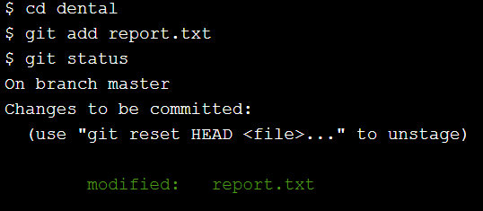
What’s the first step in saving changes?
Commit changes to a Git repository in two steps:
Add one or more files to the staging area.
Commit everything in the staging area.
指令：< git add filename>
輸入 git add report.txt 之後
用 git status 看狀態
可以發現 report.txt 已經變成綠色字體

Slide 10
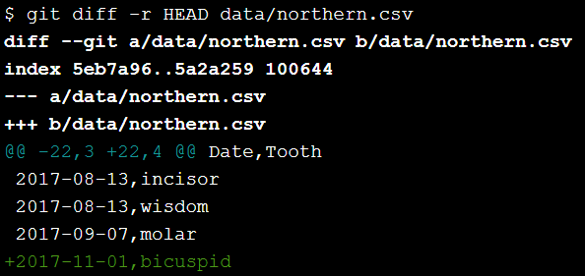
How can I tell what’s going to be committed?
<git diff –r HEAD path/to/file>
-r flag means compare to a particular revision
HEAD is a shortcut meaning “the most recent commit”

Slide 11
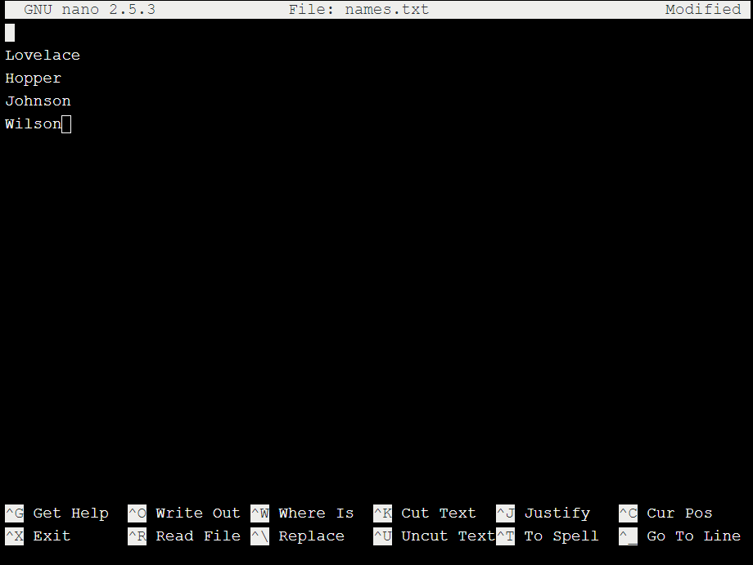
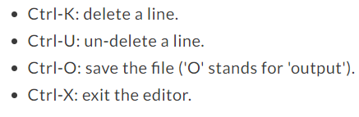
How can I edit a file? (nano as example)
<nano filename> 輸入此指定，若原本有檔案，則會用 nano 開啟。若原本沒有該檔案，則會創造一個出來並用 nano 開啟。
(左圖) 用 nano 開啟一個名叫 names.txt 的檔案。
編輯完成之後 Ctrl-O 儲存檔案 (按 Enter 確認)，Ctrl-X 退出編輯器。

Slide 12
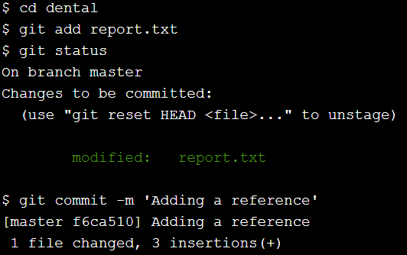
How do I commit changes?
<git commit –m ‘Program appears to have become self-aware’>
編輯 commit 的 log message，為了讓下次使用者知道有那些被修改過。

Slide 13
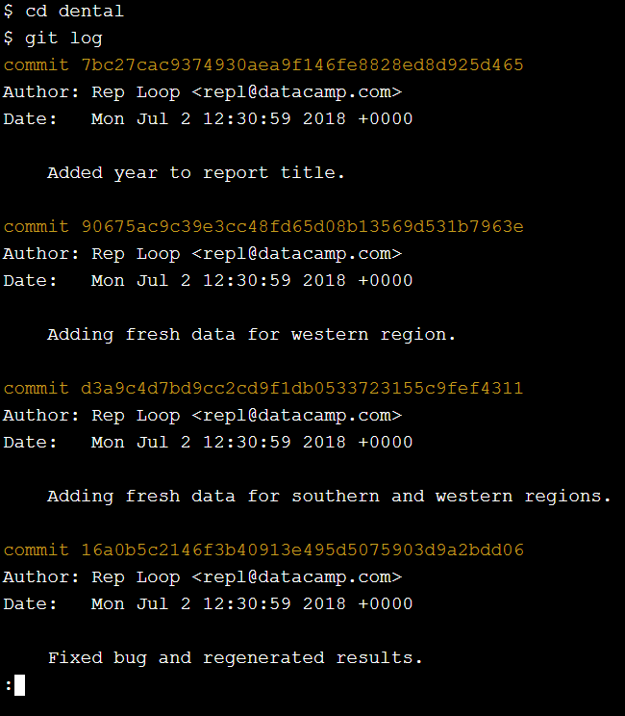
How can I view a repository’s history?
The command <git log> is used to view the log of the project’s history.
Commit 那行稱為 hash (稍後補充)
下方則是作者和log message內容與時間。
按空白鍵可以往下看，越上方的資料越接近現今。
按 ‘q’ 可退出 git log 模式

Slide 14
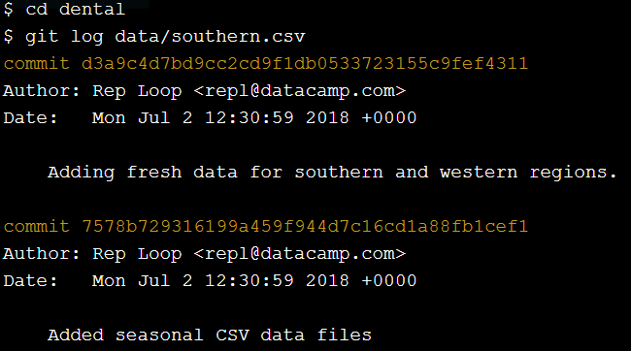
How can I view specific file’s history?
<git log path> where path is the path to a specific file or directory

Slide 15
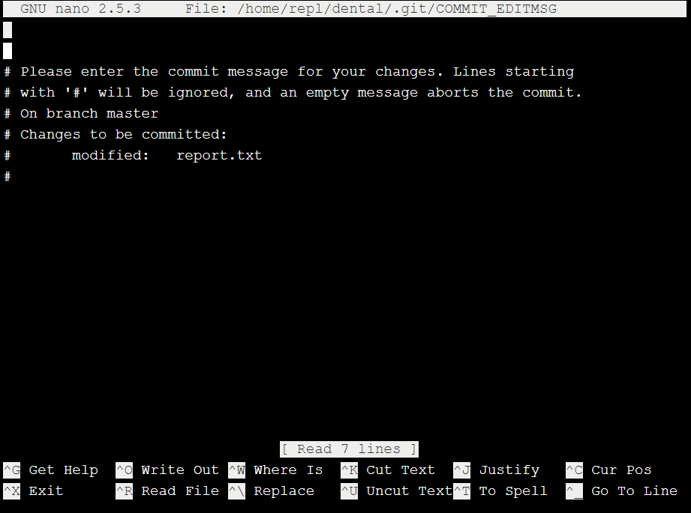
How do I write a better log message?
<git commit> : Git launches a text editor with a template.
可以編輯比較詳細的內容
# 開頭的不會被儲存，只是提示你可以寫一些什麼內容
可以注意到這個文字編輯器是 nano 所以操作方式如同前面教學。

Slide 16
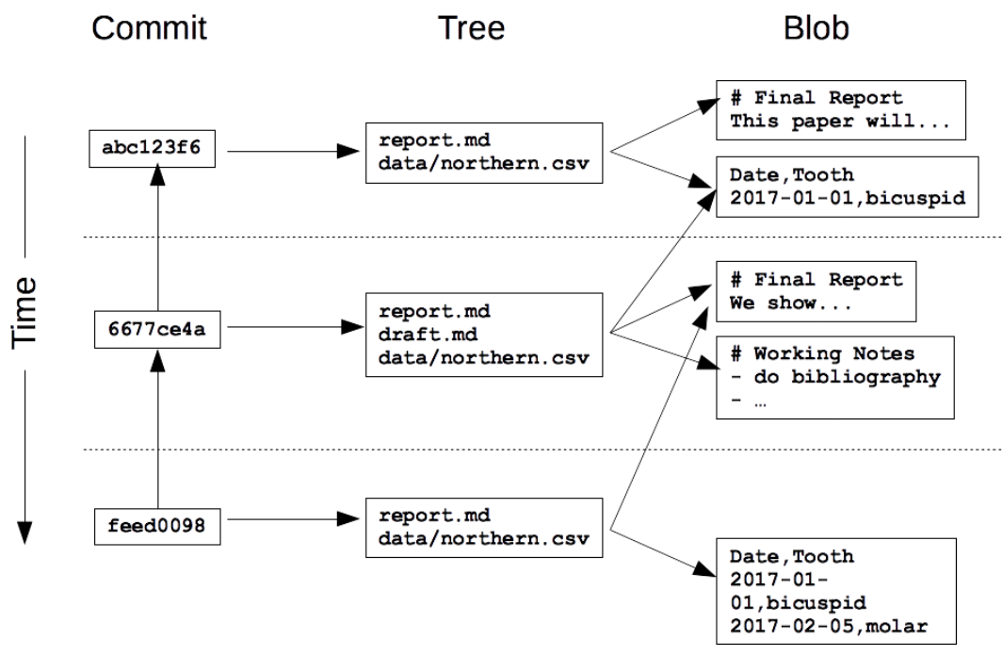
How does Git store information?
Git uses a multilevel structure to store data. (fast, minimize storage space).
1. Every unique version of every file. (Git calls these blobs because they can contain data of any kind)
2. Tree that tracks the names and locations of a set of files.
3. A commit that records the author, log message, and other properties of a particular commit.

Slide 17
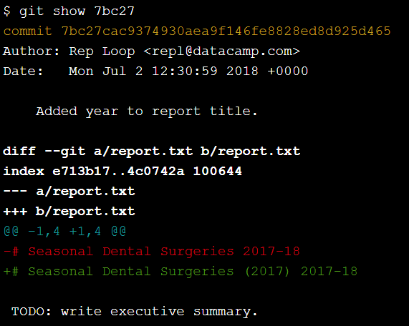
What is hash?
40-character hexadecimal string
由 hash function 製作出的 Pseudo-random number (假隨機)
Most of the time, you only have to give Git the first 6 or 8 characters in order to identify the commit you mean.
Git can therefore tell what information needs to be saved where by comparing hashes rather than comparing entire files.
<git show hash>
可以找尋特定檔案的歷史，對比 git log 是整個 repository 的歷史。
Hash 的部分就是輸入最前面幾碼通常就可以

Slide 18
What is Git’s equivalent of a relative path?
The special label HEAD, always refers to the most recent commit. HEAD~1 then refers to the commit before it. HEAD~2….. (tilde 前後不能有空格)。

Slide 19
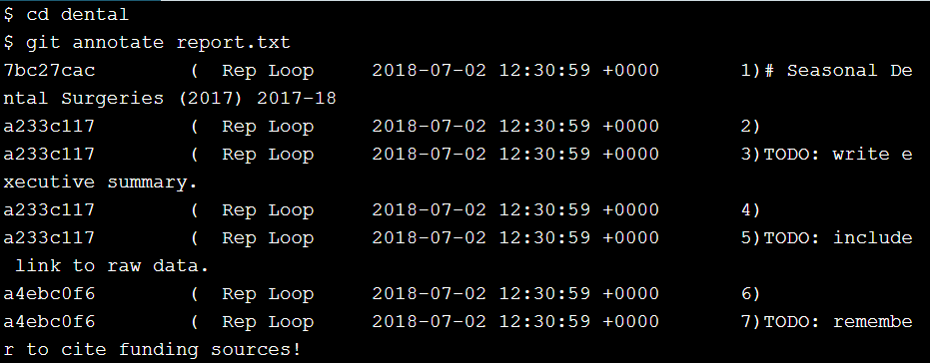
How can I see who changed what in a file?
<git annotate file> shows who made the last change to each line of a file and when.
基本上一個 hash號碼，代表一次修改次數。
以左圖為例：
總共有 3 次修改：7bc27cac, a233c117, a4ebc0f6

Slide 20
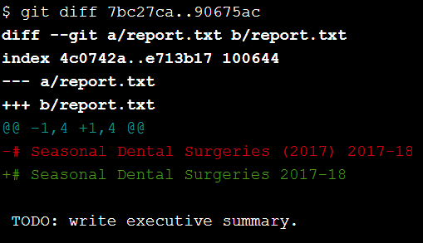
How can I see what changed two commits?
<git diff ID1..ID2>

Slide 21
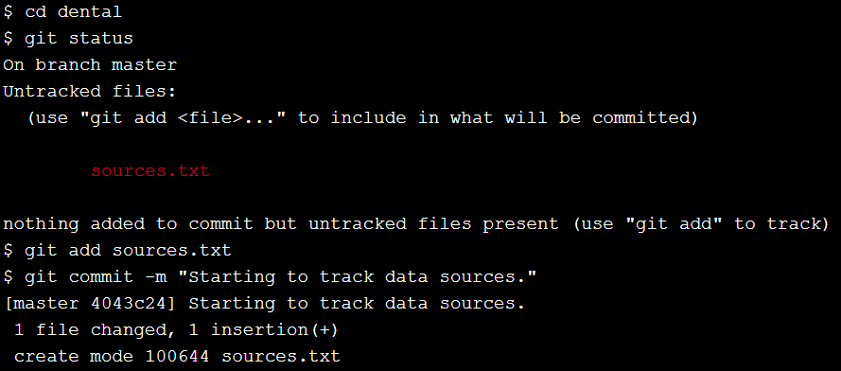
How do I add new files?

Slide 22
How do I tell Git to ignore certain files?
<.gitignore>
如果 .gitignore 包含 build, *.mpl，則被包含的檔案即會被 Git 忽略。
如果有權不包含關鍵字的檔案或是資料夾名稱，則需要加入 wildcard ‘*’。不然就只能忽略跟 line 一模一樣。
比如 .gitignore 有 line 為 pdf，但因為 pdf 沒有 wildcard 符號，所以 Git 只會忽略檔名或是資料夾叫做 pdf 的檔案，apple.pdf 則不會被忽略。

Slide 23
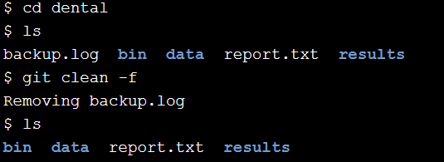
How can I remove unwanted files?
<git clean –n> will show you a list of files that are in the repository, but whose history Git is not currently tracking.
<git clean -f> will delete those files.

Slide 24
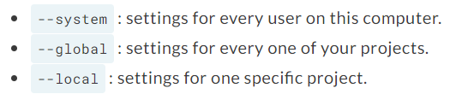
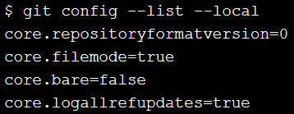
How can I see how Git is configured?
Git allows you to change its default settings.
<git config --list + --system/--global/--local>

Slide 25
How can I change my Git configuration?
<git config --global setting.name setting.value>
With the setting’s name and value in the appropriate places. The keys that identify your name and email address user.name and user.email respectively.

Slide 26
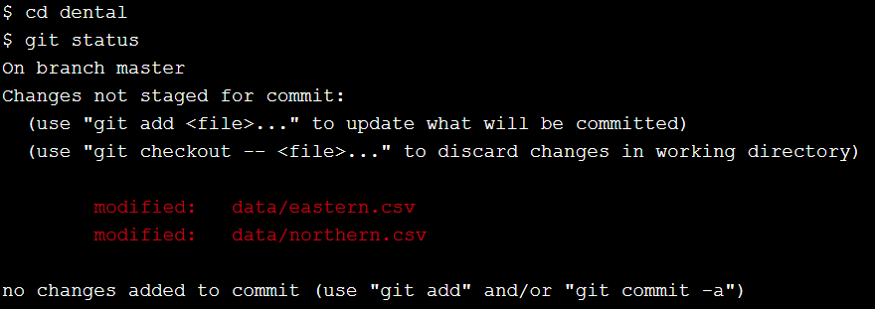
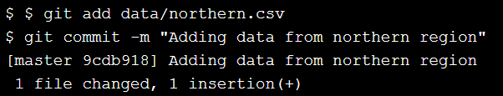
How can I commit changes selectively?

Slide 27
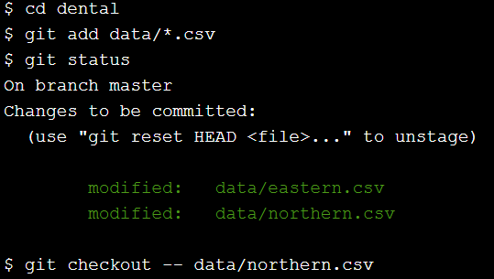
How can I undo changes to unstaged files?
<git checkout -- filename> discard the changes that have not yet been staged. Checkout 要小心使用，一旦丟棄的檔案將會永久消失。

Slide 28
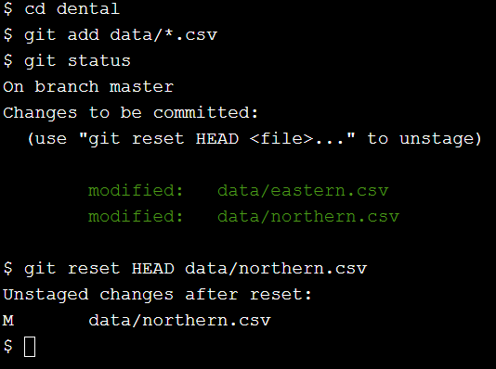
How can I unstage a file that I have staged?
<git reset HEAD filename> undo changes that have been staged. However, it doesn’t restore the file to the state it was in before you started making changes. Instead, it resets the file to the state you last staged.

Slide 29
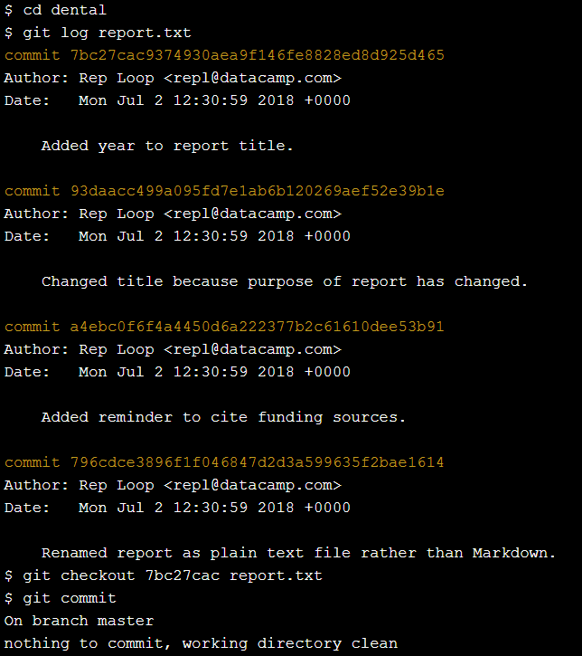
How do I restore an old version of a file?
<git checkout hash file_name>

Slide 30
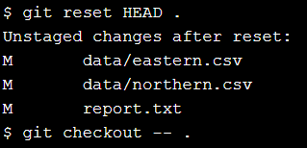
How can I undo all of the changes I have made?
<git reset HEAD directory_name> will unstage any files from the directory_name directory that you have staged.
<git checkout -- data> restore those files to their previous state
‘ . ‘ dot 表示目前所在的資料夾，或是在此資料夾的所有檔案。

Slide 31
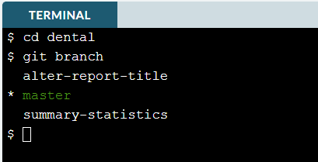
Branch: a parallel universe
Changes you make in one branch do not affect other branches until you merge them back together.
How can I see what branches my repository has?

Slide 32
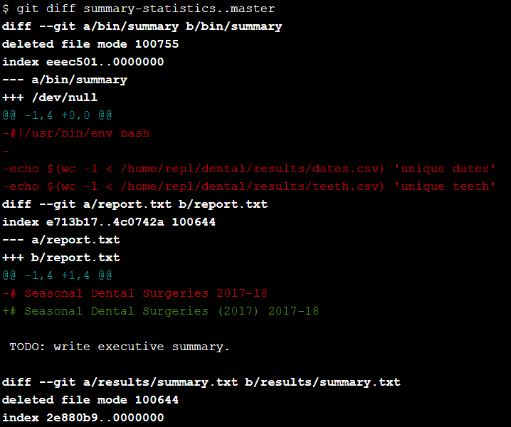
How can I view the differences between branches?
$ git diff summary-statistics..master
顯示這兩個 branch 的差別，記得..前後不要有空格。

Slide 33
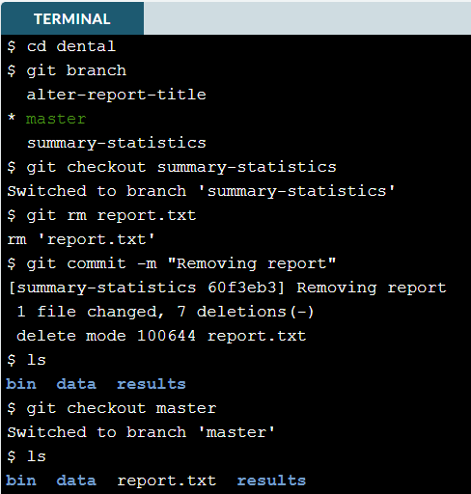
How can I switch from one branch to another?
$ git checkout branch-name 1. Switch to summary-statistics branch
2. use git rm to delete report.txt
3. commit your change 4. use ls to check that it is gone 5. switch back to maser and use ls to ensure report.txt is still there

Slide 34
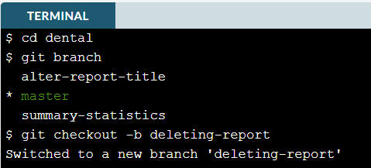
How can I create a branch
The easiest way to create a new branch is to run $ git checkout –b branch-name which creates the branch and switches you to it. The contents of the new branch is identical to the contents of the original. Once you start making changes, they only affect the new branch.

Slide 35
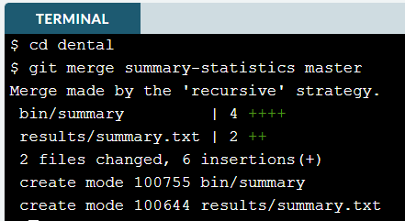
How can I merge two branches?
$ git merge source_branch_name destination_branch_name

Slide 36
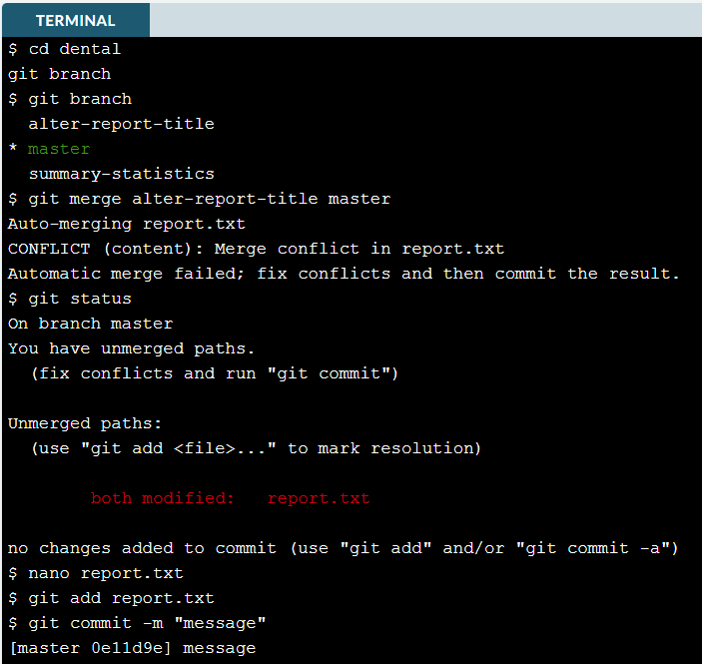
How can I merge two branches with conflicts?
1. Megre and find conflict
2. $git status (to see which file has conflicts.)
3. use text editor like nano to remove the conflict markers.
4. add and commit your changes.

Slide 37

How can I create a brand new repository?
Create a new repository called optical.

Slide 38
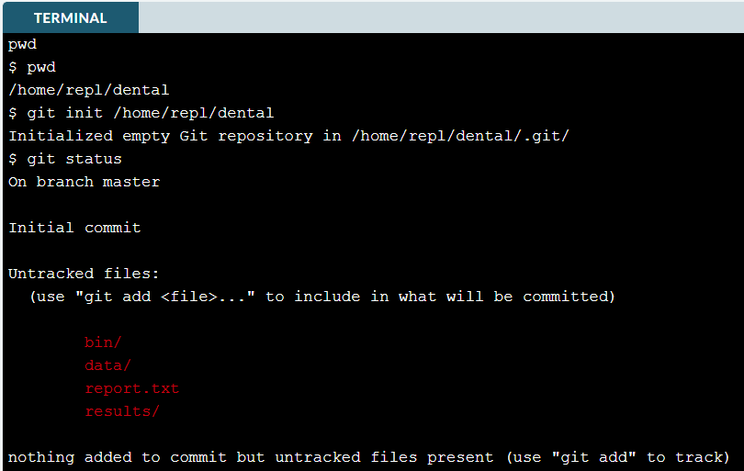
How can I turn a existing project into a Git repository?
將本地資料夾變成可以給 Git 控管：
$ git init /Path/to/File
結束後可以用 git status 看狀態

Slide 39
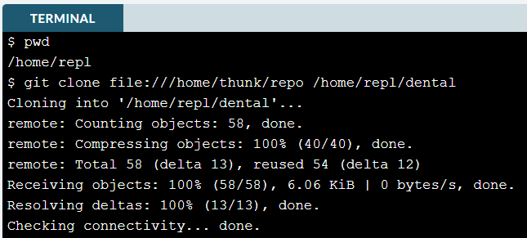
How can I create a copy of an existing repository?
$ git clone URL destination/file_name
(URL=identity of the repository you want to clone)

Slide 40
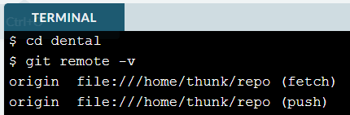
How can I find out where a cloned repository originated?
$ git remote -v

Slide 41

How can I define remotes?
$ git remote add remote-name URL
$ git remote rm remote-name you are in the dental repository. Add file:///home/thunk/repo as a remote called thunk to it.

Slide 42
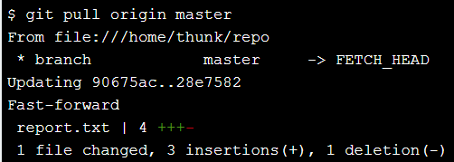
How can I pull in changes from a remote repository?
Git keeps track of remote repositories so that you can pull changes from those repositories and push changes to them.
$ git pull remote branch (get everything in branch)
You are in quarterly-report branch of your local repository, the command: $git pull thunk latest-analysis (would get changes from latest-analysis branch in the repository associated with the remote called thunk and merge them into your quarterly-report branch.
Origin 為 remote
Master 為 branch

Slide 43
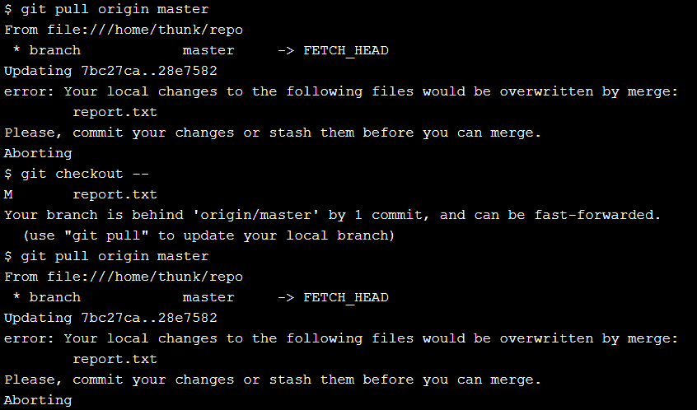
What happens if I try to pull when I have unsaved changes?

Slide 44
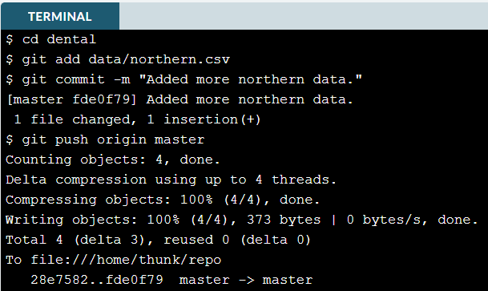
How can I push my changes to a remote repository?
$git push remote-name branch-name
You are in the master branch of the dental repository, which has a remote called origin. You have changed data/northern.csv; add it to the staging area.
Commit your changes with the message “Added more northern data.”
Push your changes to the remote repository’s master branch.

Slide 45
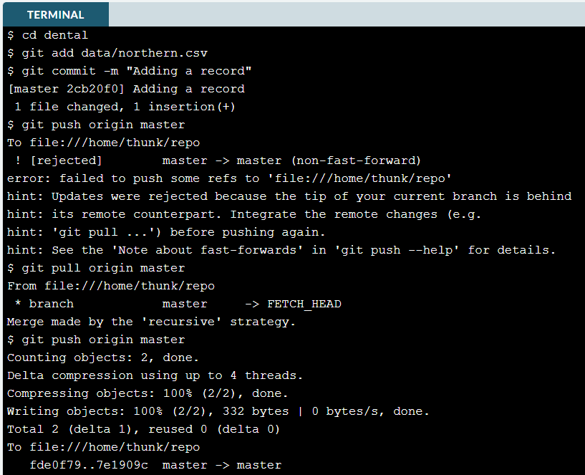
What happens if my push conflicts with someone else’s work?
1. you have made changes to the dental repository. Use git push to push those changes to the remote repository
2.In order to prevent you overwriting remote work, Git has refused to execute your push. Use git pull to bring your repository up to date with origin
3 Now that you have merged the remote repository’s state into your local repository, try the push again.

